Slide 1
License Plate Localization and Character Recognition
Stone Preston
Faranak Abri
Truong Dinh

Slide 2
Problem Statement
Isolate the license plate and read the plate numbers for various rear images of cars

Slide 3
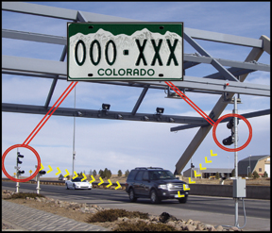
Motivation
Automatic billing for toll roads
Parking violations
Automatic gates for parking garages
Law Enforcement and Government surveillance : (

Slide 4
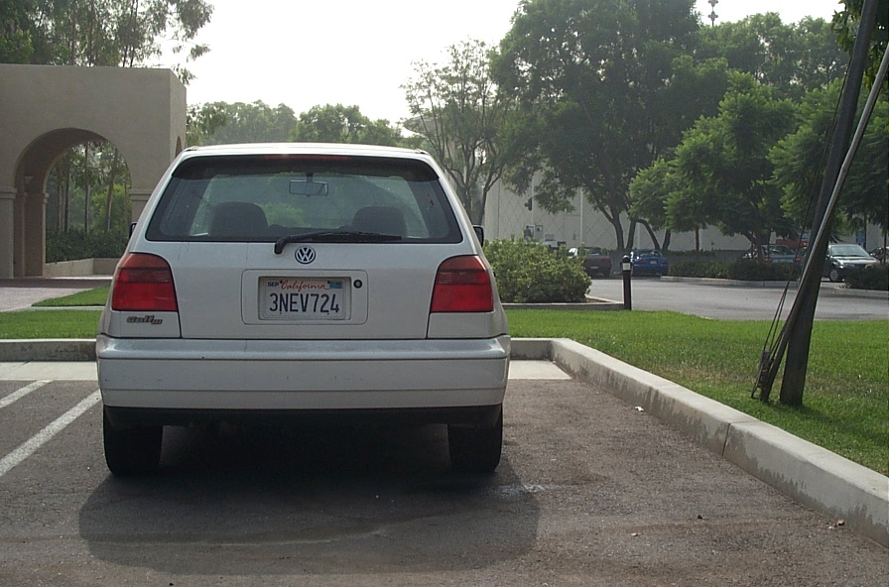
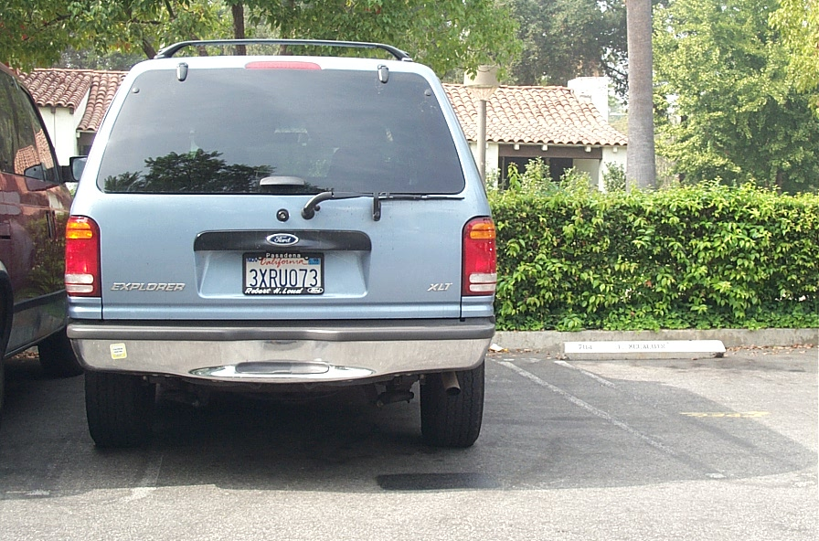
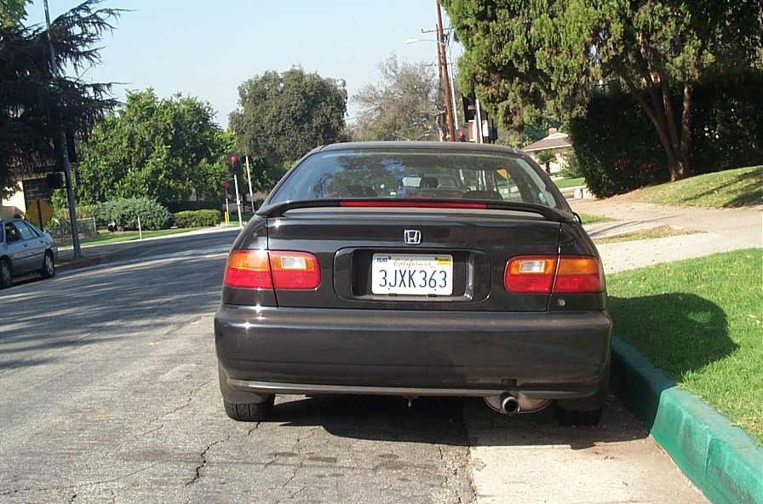
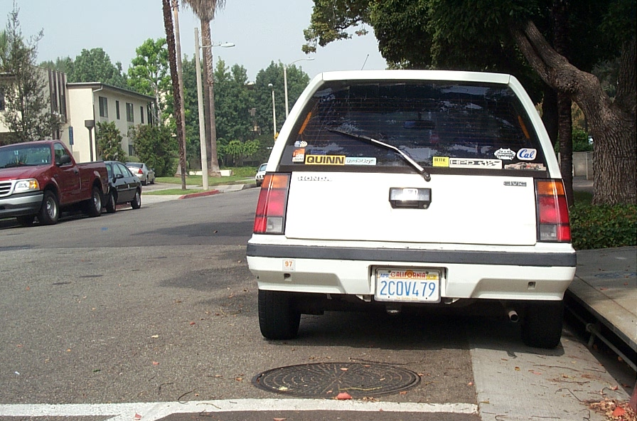
Implementation overview
MATLAB R2019b was used to conduct the image processing tasks
Caltech cars 1999 dataset was used as the image set (126 images)
Images are 592 x 896 color images of the rears of cars photographed around Caltech

Slide 5
Theoretical Underpinnings
HSV color space
Connected Component Analysis
Edge Histogram Analysis
Binary Image Morphology
Binarization
Top Hat Filtering
Template Matching via cross-correlation
Optical character recognition

Slide 6
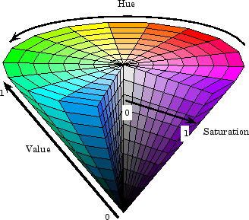
HSV color space
The HSV color space is very practical compared to RGB and much more Intuitive
The hue channel provides color information
The saturation channel provides information about the vividness of the color
The value channel provides brightness information

Slide 7
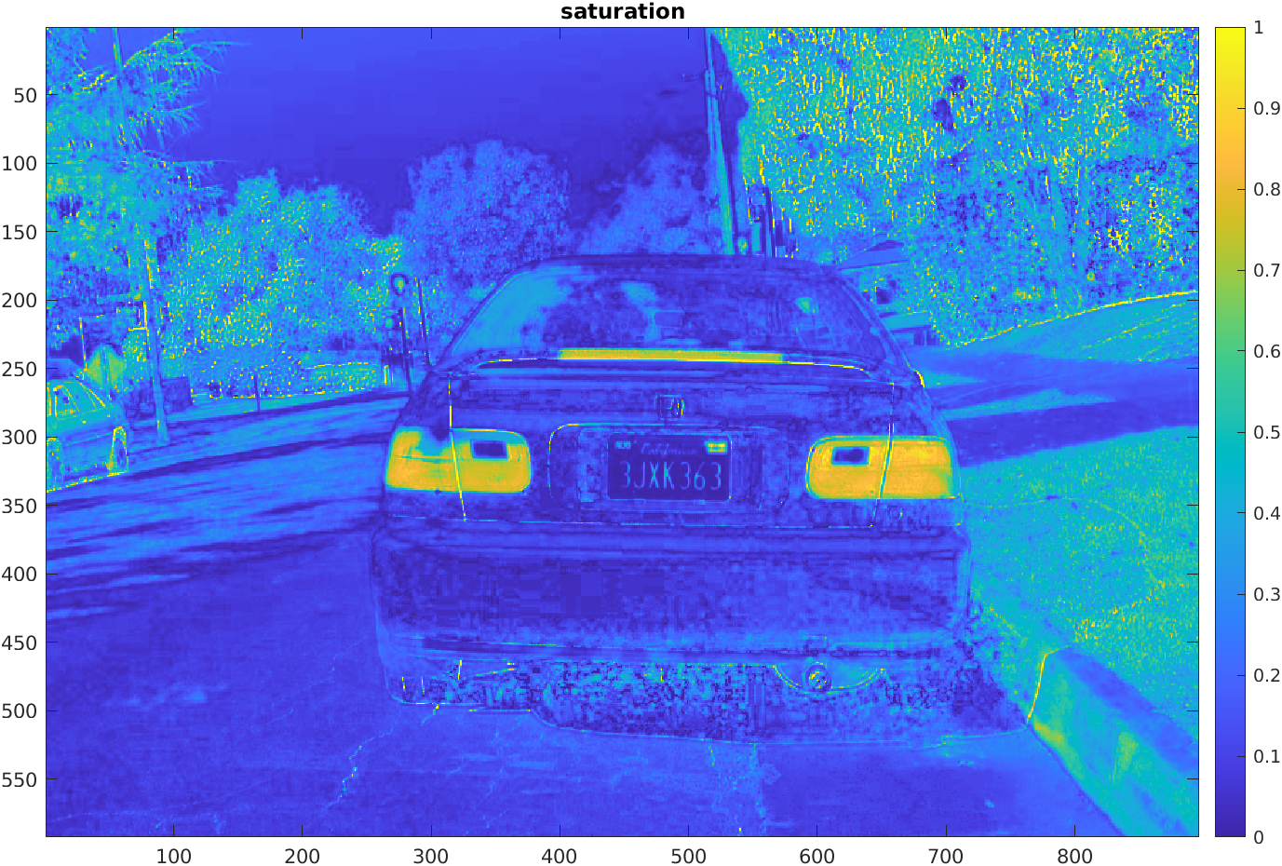
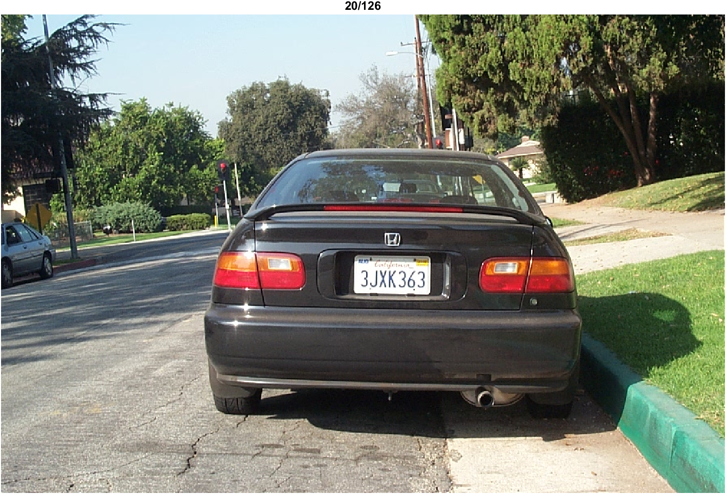
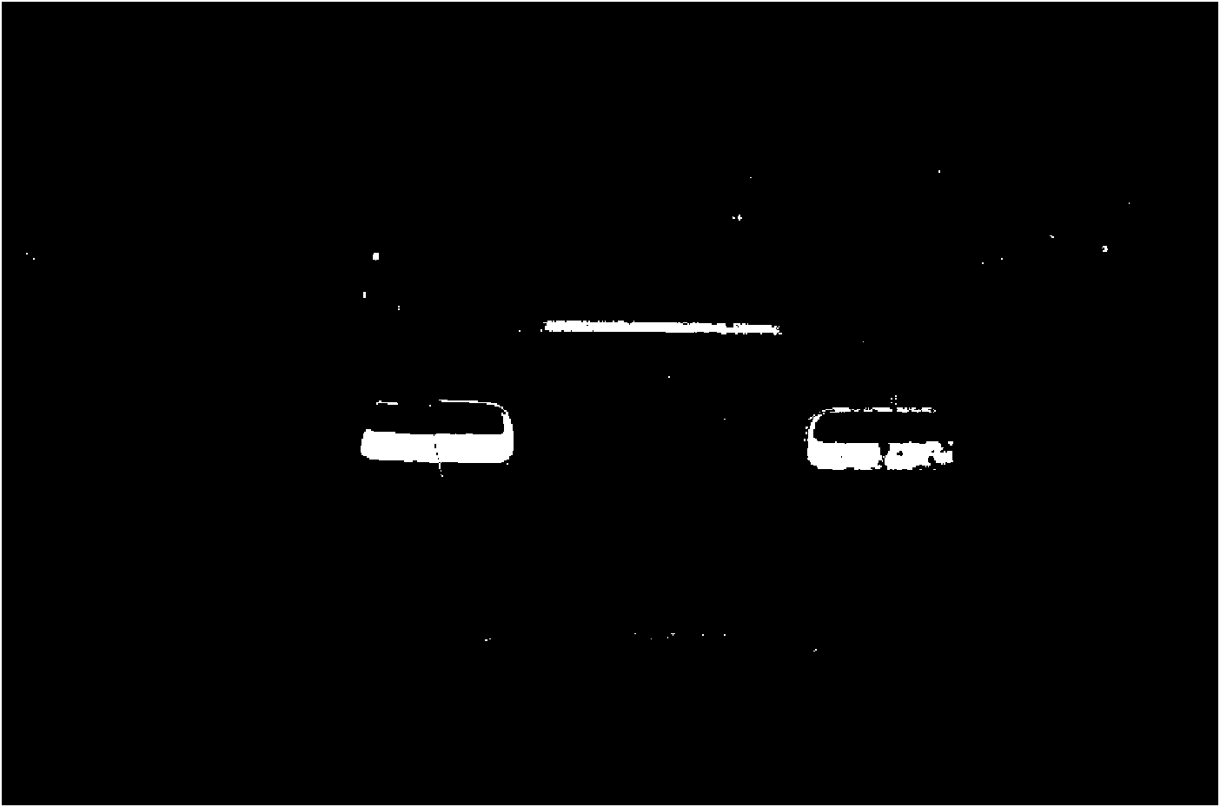
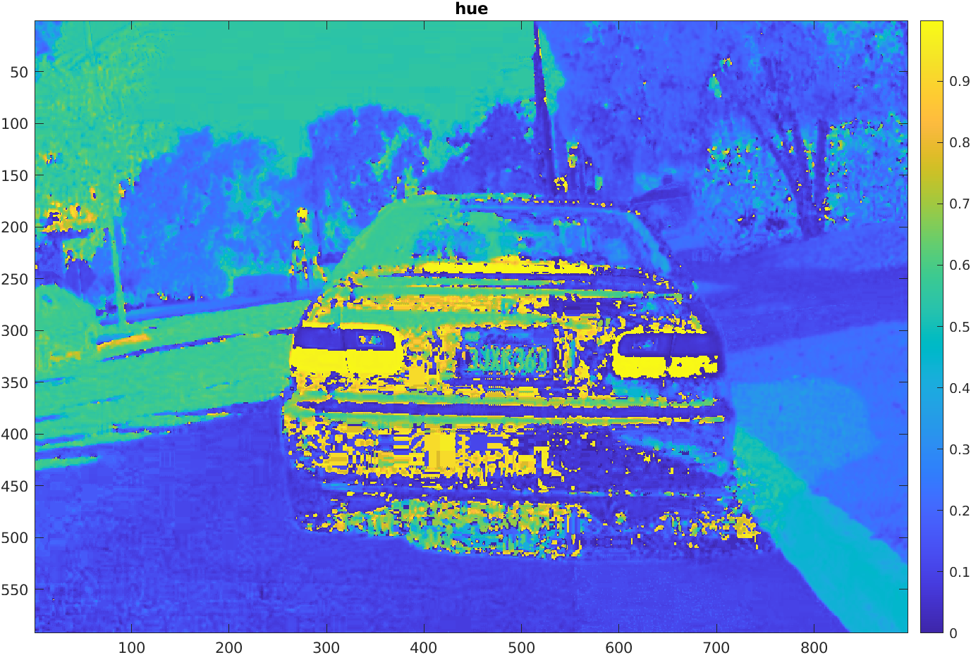
Car Tail-Lights are red and this information can be used to extract the car from the image in order to remove it from the complex background
Regions with a red hue and Medium to high saturation were used to localize the tail-lights

Slide 8
Connected component analysis
Basic algorithm is as follows:
Start from the first pixel in the image. Set current label to 1. Go to (2).
If this pixel is a foreground pixel and it is not already labelled, give it the current label and add it as the first element in a queue, then go to (3). If it is a background pixel or it was already labelled, then repeat (2) for the next pixel in the image.
Pop out an element from the queue, and look at its neighbours (based on any type of connectivity). If a neighbour is a foreground pixel and is not already labelled, give it the current label and add it to the queue. Repeat (3) until there are no more elements in the queue.
Go to (2) for the next pixel in the image and increment current label by 1.

Slide 9
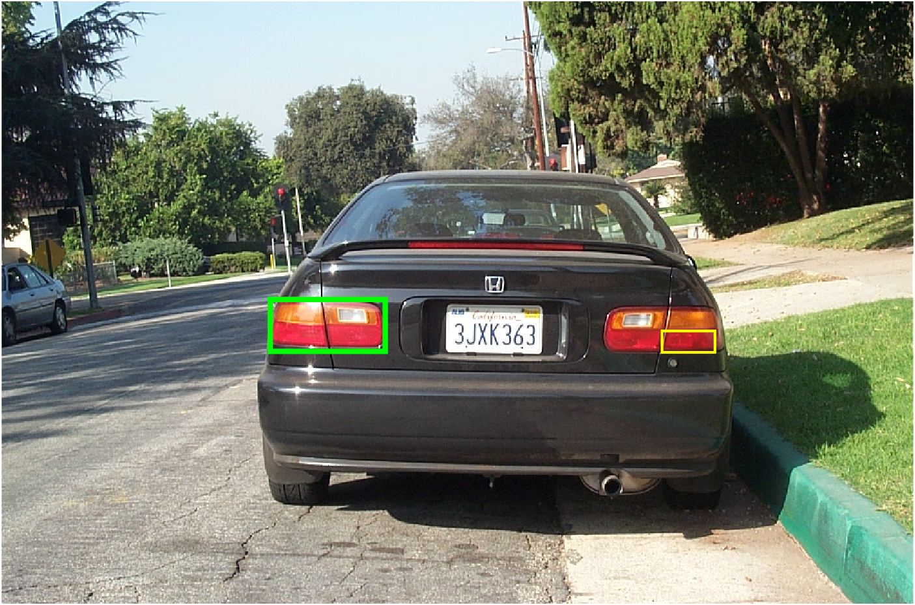
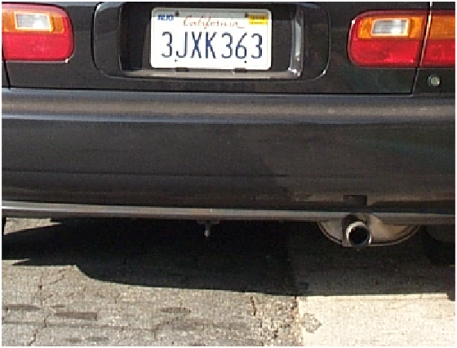
MATLAB function Bwlabel conducts CCA, and the labels it generates can be used in conjunction with the regionprops function to obtain bounding boxes and area information of the connected components
Small areas were not considered, and the region was cropped based on the left and right-most bounding boxes

Slide 10
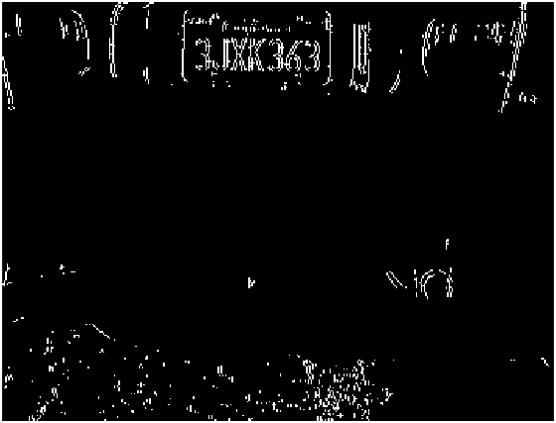
Edge Histogram Analysis
Edge information is useful for determining regions of an image that change abruptly. Once the car has been cropped out of the background, most of the image is uniform with the exception of the license plate, which contains many (vertical) edges
Vertical Edge Sobel Filter

Slide 11
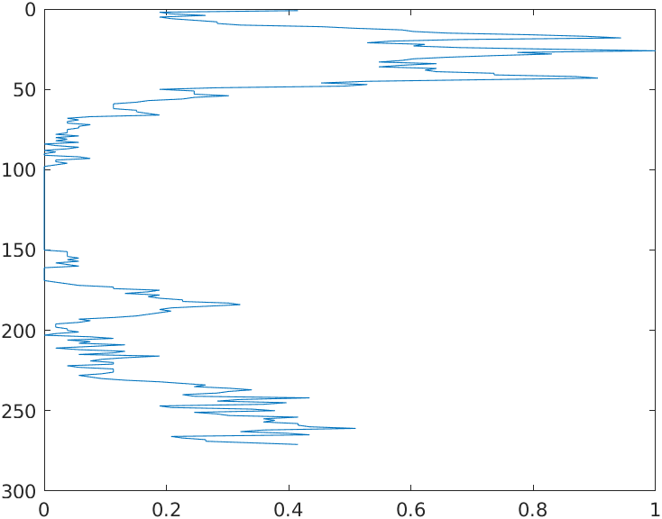
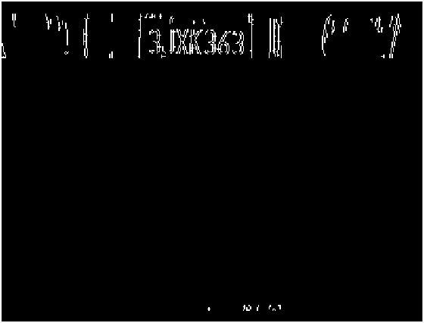
The license plate has a high density of vertical edges in comparison to the rest of the car
Row-wise histogram of vertical edges was used to determine these high density locations
Pixels that were not in high density rows and small areas were discarded

Slide 12
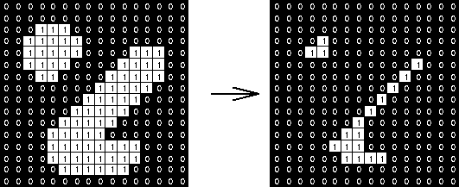
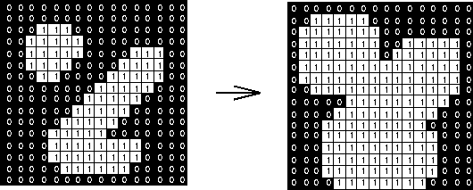
Binary Image Morphology
The two basic operations of Binary Image Morphology are Dilation and Erosion
Erosion with a structuring element is commonly used to strip away image elements, while dilation with a structuring element is used to grow them

Slide 13
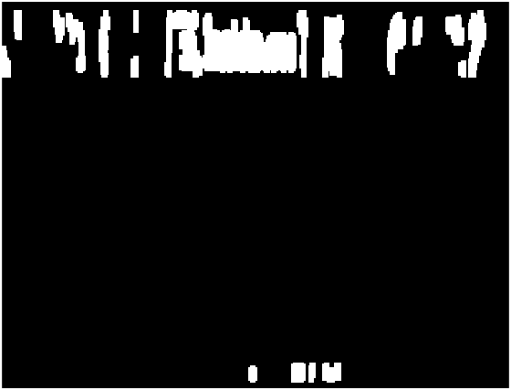
The binary license plate edge image can be dilated with a small structuring element (4 x 10 rectangle) to produce Large connected regions
Dilation and Hole Filling

Slide 14
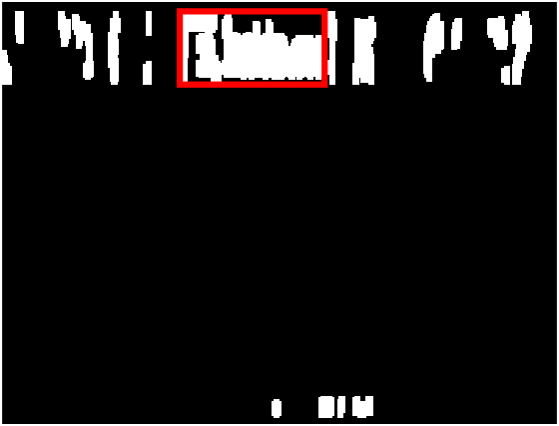
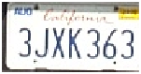
CCA was used once more
The largest area present is the license plate. The bounding box for that area can be used to crop the license plate

Slide 15
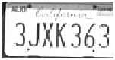
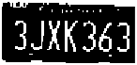
Binarization
Otsus method is used to binarize the cropped plate by maximizing inter-class variance of the foreground and background pixels
MATLAB provides the graythresh function that implements this method
This process is the most crucial one. If binarization goes wrong, the characters cannot be extracted

Slide 16
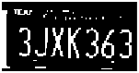
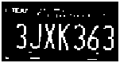
Top Hat Filtering
Top hat filtering is done by computing the opening (erosion followed by dilation) of an image with a structuring element and subtracting the result from the original image
This effectively removes foreground pixels that the structuring element fits completely inside
A long 12 x 1 structuring element was used to remove the upper and lower plate covers, and a tall 1 x 25 structuring element was used to remove the left and right plate covers

Slide 17
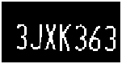
The 7 largest connected components are kept and the rest removed using the bwareafilt function resulting in the license plate characters alone

Slide 18
Template matching via Cross-correlation
CCA is used once more to extract the individual characters from the plate
Each character is compared to all characters in a “Template” character set using cross-correlation via the imcorr2 matlab function
The template character that produced the highest correlation coefficient was chosen as the matched character

Slide 19












Template characters were created using the Dealerplate font for all characters 0-9 and A-Z
This font closely resembles the one used for most license plates in the united states

Slide 20
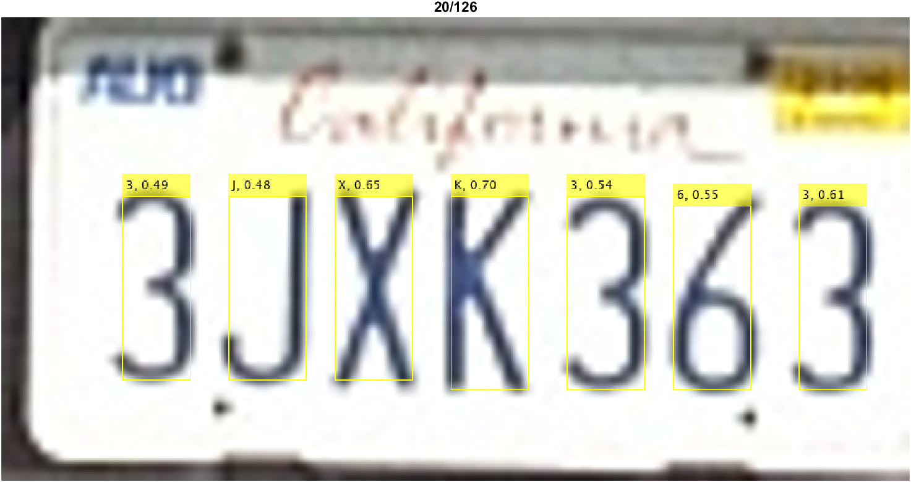
The template matched letters and their corresponding correlation coefficients are shown below. The process of obtaining these results takes an average of .65 seconds for each image

Slide 21

Optical Character Recognition (OCR)
MATLAB’s OCR function was also used to provide a comparison for our template matching method. The recognized characters and confidence values for one test image are shown below. The process takes around .1 seconds for each image.

Slide 22
License Plate Localization Results

Slide 23
Character Recognition Results
Overall (Correlation): 49.43 %
Overall (OCR): 38.32 %

Slide 24
Comparison to Machine Learning ApproachES
Li, Hui, Peng Wang, Mingyu You, and Chunhua Shen achieved a plate localization accuracy of 95.24 % on the Caltech dataset using a CNN
Selmi, Halima, and Alimi achieved a character recognition accuracy of 94.8 % on the Caltech dataset using a CNN

Slide 25
References
Nejati, Mansour, Ali Majidi, and Morteza Jalalat. "License plate recognition based on edge histogram analysis and classifier ensemble." In 2015 Signal Processing and Intelligent Systems Conference (SPIS), pp. 48-52. IEEE, 2015.
Kode4U Dev. “Matlab Number Plate Detection.” YouTube. YouTube. Accessed December 2, 2019. https://www.youtube.com/watch?v=woB2Fd0gkHM.
Morphology Filters. Accessed December 2, 2019. http://www.theobjects.com/dragonfly/dfhelp//Content/05_Image Processing/Morphology Filters.htm.
“Connected-Component Labeling.” Wikipedia. Wikimedia Foundation, October 14, 2019. https://en.wikipedia.org/wiki/Connected-component_labeling.
“Dealerplate California.” Dealerplate California Font. Accessed December 2, 2019. https://www.dafont.com/dealerplate-california.font.
Li, Hui, Peng Wang, Mingyu You, and Chunhua Shen. "Reading car license plates using deep neural networks." Image and Vision Computing 72 (2018): 14-23.
Selmi, Zied, Mohamed Ben Halima, and Adel M. Alimi. "Deep learning system for automatic license plate detection and recognition." In 2017 14th IAPR International Conference on Document Analysis and Recognition (ICDAR), vol. 1, pp. 1132-1138. IEEE, 2017.
L. Fei-Fei, R. Fergus and P. Perona. Learning generative visual models from few training examples: an incremental Bayesian approach tested on 101 object categories. IEEE. CVPR 2004, Workshop on Generative-Model Based Vision. 2004

